Slide 1
Preparation, In-vitro and Ex-vivo Evaluation of Ondansetron Loaded Invasomes for Transdermal Delivery
Omar Saeb Salih (Author)
Ph.D. Student / Department of Pharmaceutics, College of Pharmacy, University of Baghdad, Baghdad, Iraq.
Entidhar Jasim Al-Akkam (Co-Author)
Department of Pharmaceutics, College of Pharmacy, University of Baghdad, Baghdad, Iraq.
المؤتمر العلمي الثاني لبحوث طلبة الدراسات العليا
19 – 20 اذار 2023

Slide 2
Abstract
Invasomes are newly developed type of vesicles. A vesicular drug delivery system is considered one of the approaches for transdermal delivery to facilitate permeation and improve drugs efficiency.
Ondansetron is a serotonin receptor antagonist used for treatment emesis associated with different clinical cases especially emesis associated with chemotherapy.
Twenty-seven formulas of ondansetron-loaded invasomes (1% w/v) were prepared by a modified mechanical dispersion method.

Slide 3
Abstract
Formulas were optimized by studying the effect of different variables on entrapment efficiency.
Vesicle size, polydispersity, zeta potential, in-vitro release and ex-vivo permeation studies were performed for the optimized formulas with higher entrapment of ondansetron.
A transmission electron microscope (TEM) was done to visualize the shape of vesicles of the selected formula.

Slide 4
Introduction
Lipophilic (log Ko/w=1-4)
Low melting point <200-250 ºC
Low molecular weight (<500 g/mol)
Short half-life (<10 h.)
Low dose (<20 mg/day)
The transdermal route is an essential route that overcomes many challenges in drug delivery. Drugs used for transdermal delivery should have several requirements
Skin Structure

Slide 5
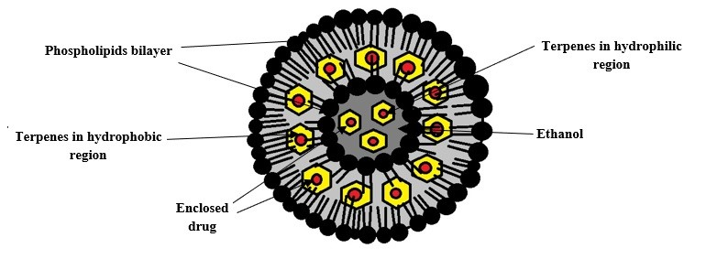
Introduction
Invasomes are newly developed types of vesicles presented by ‘‘Alfred Fahr’’ in 2016.
it consists of phospholipids as the building block for the structure of the vesicle and ethanol.
Invasomes unique in the presence of terpenes which are volatile oils of monoterpenes like cineol, fenchone, D-Limonene and pinene.
Invasome Vesicle

Slide 6
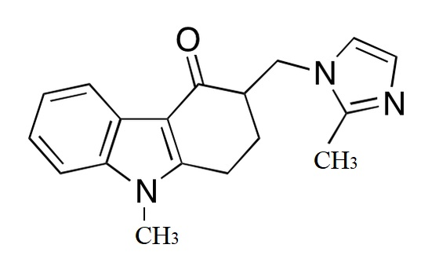
Introduction
Ondansetron is a weak base with pka 7.4, making it soluble in acidic solutions due to conversion to the salt form. According to BCS) it is considered a class II drug. It has a molecular weight of 293 g/mol and a logP value of 2.07.
Oral bioavailability is 59%-60% due to the extensive first-pass effect, melting point is 230ºC and the half-life is 3-4 hr. These properties make the drug a good candidate for transdermal delivery.

Slide 7
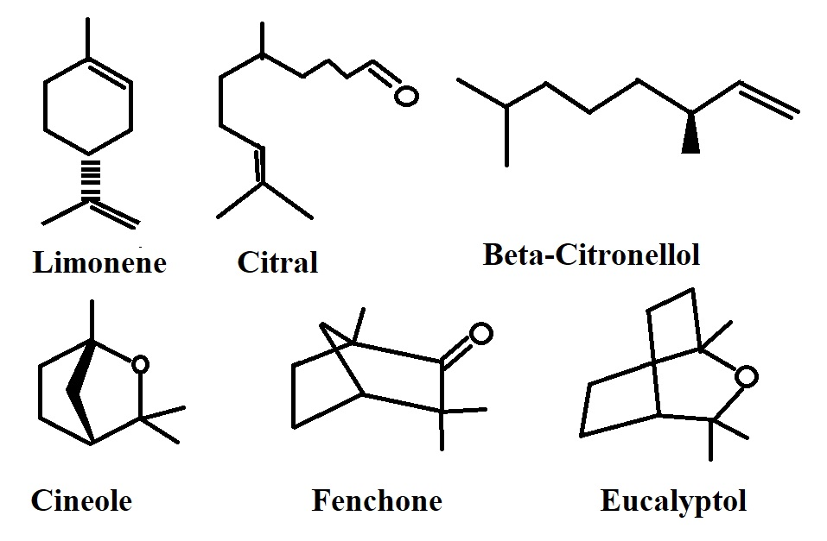
Introduction
Terpenes which are volatile oils like cineol, fenchone, and limonene. They are used in dermal formulations because they act as permeation enhancer across the skin layers which facilitate the entry of active ingredients across the stratum corneum.
In comparison to synthetic permeation enhancers, terpenes derived from natural sources (mainly plants) so they are safer to use.

Slide 8
Literature Review
Nanoparticles loaded microneedle
Ethosomes and transfersomes
Bilosomes
Ondansetron was delivered as nanoparticles transdermally using microneedle technology. the transdermal permeation study show that nanoparticles permeate efficiently than aqueous solution of the drug through the skin by approximately two-fold.
Study showed that the prepared ONDS transfersomes proved to be better than ethosomes. It also showed good deformability and promising results in transdermal permeation through rat skin.
Ondansetron could be formulated as bilosomes vesicles and delivered transdermally for effective permeation and systemic effect.
in-vivo skin permeation studies in rats demonstrated that bilosomes systems enhanced ondansetron permeation.
Earth
Jupiter

Slide 9
The aim of the study was to prepare and evaluate ondansetron loaded invasomes dispersions
Aim of the study
Selection of the optimized formulas based upon the percent of entrapment efficiency.
Optimized dispersions were evaluated for size, polydispersity, zeta potential, In-vitro release and ex-vivo permeation across rat skin.
The selected formula with higher flux could be considered for further evaluations.

Slide 10
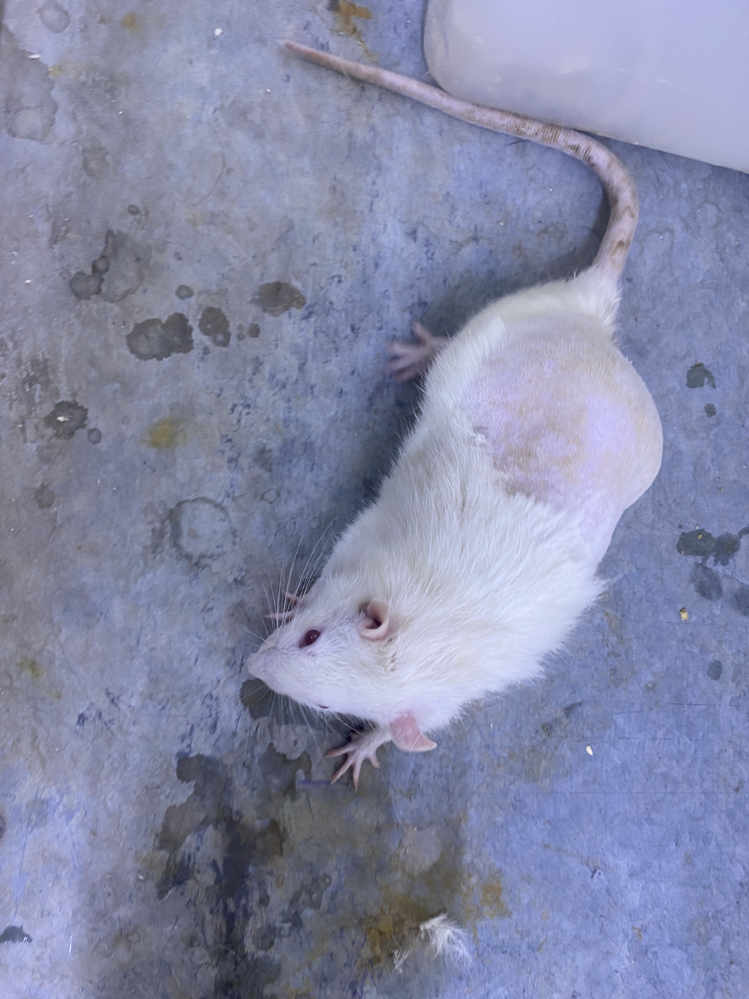
Wistar male albino rats weighing (200±20 g) were provided from the animal house facility in the College of Pharmacy / University of Baghdad.
Animals for ex-vivo
study
The ethical approval code is (REAFUBCP11210204A) on 01-12-2021.

Slide 11
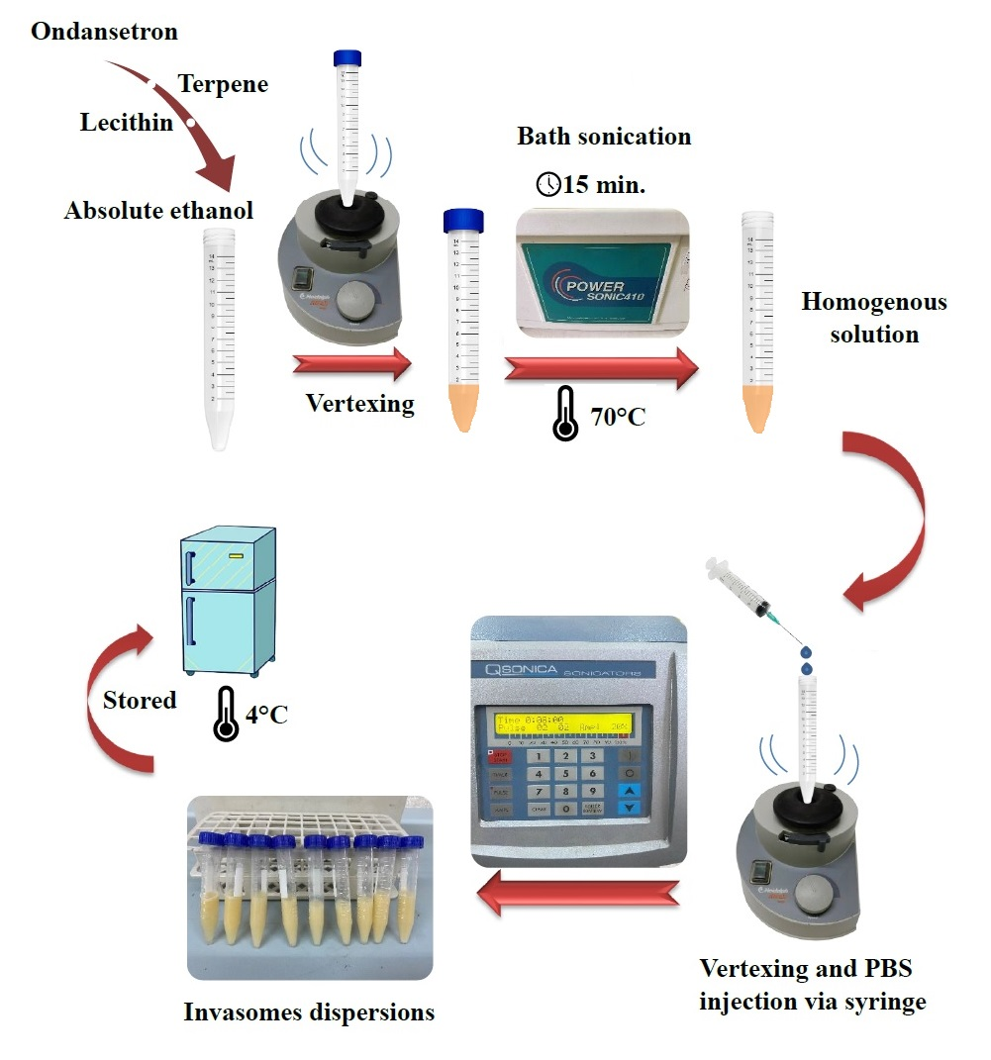
Methodology
Preparation of ondansetron invasomes
dispersions
Composition of Ondansetron Loaded Invasomes

Slide 12
Methodology
Concentration of ondansetron using UV spectrophotometer
Concentration of ondansetron using UV spectrophotometer
Measured from UHPLC 2060C 3D equipped with PDA (Shimadzu, Japan).
The flow rate was 1.2 ml/ min.
The mobile phase used was methanol: Acetonitrile (50:50) HPLC grade. The process was done at 5ºC with an injection volume of 10 µl. The retention time was 3 min. and the process run time was 5 min.
Measured from absorbance in UV spectrophotometer at 310 nm for BPS.
Measured at 302 nm by UV spectrophotometer at 310 nm for absolute ethanol.
Mercury

Slide 13
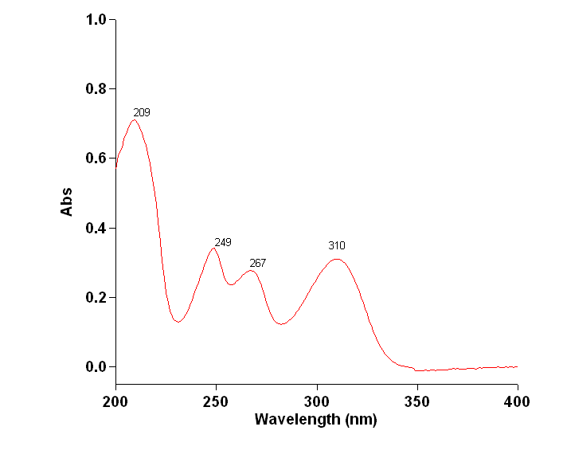
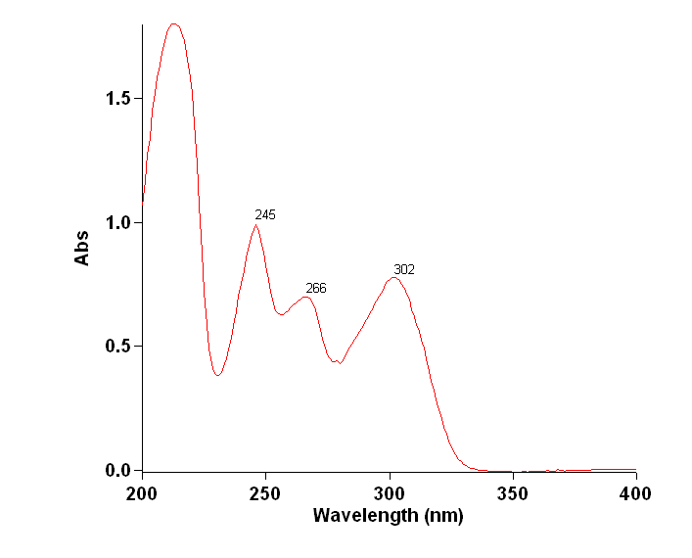
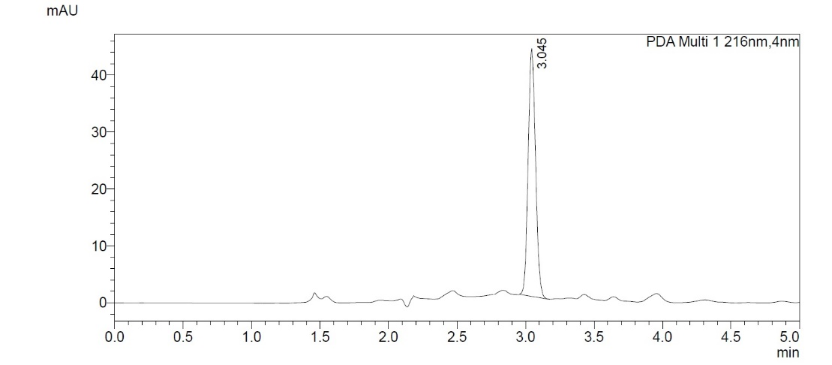
Methodology
PBS 7.4 Scan
Absolute ethanol Scan
UHPLC
chromatogram

Slide 14
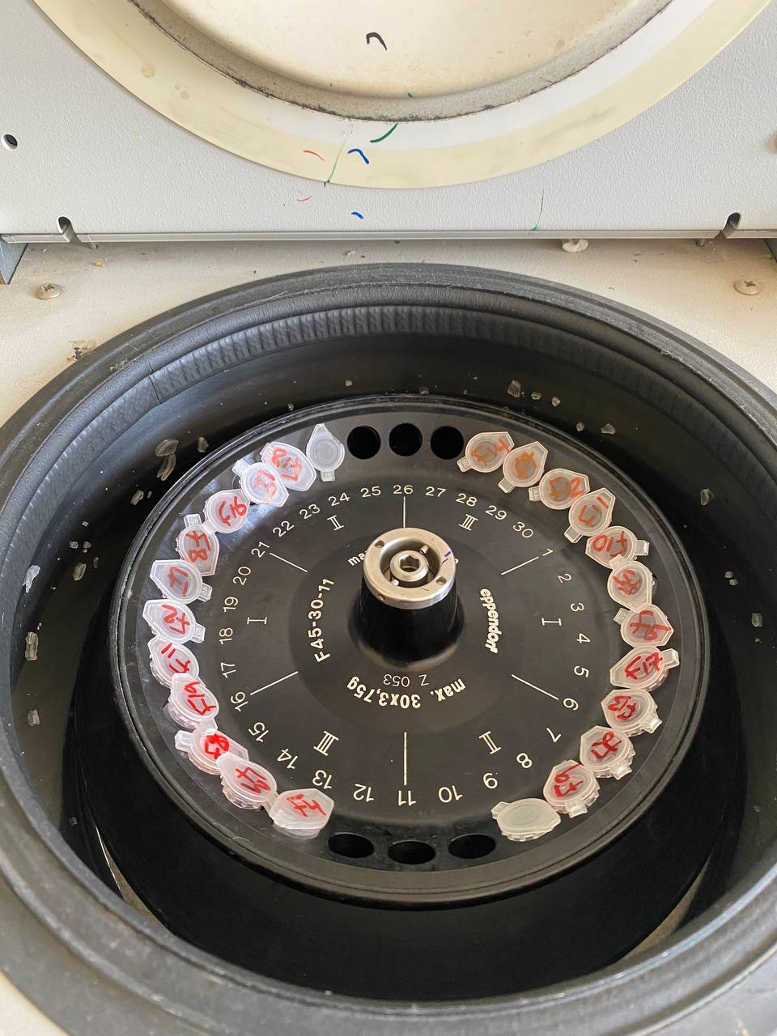
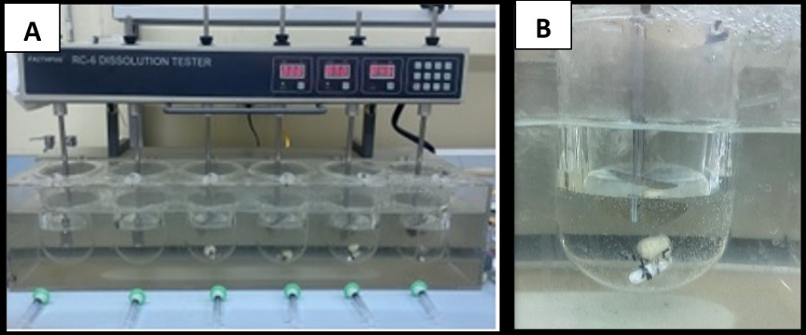
Methodology
Determination of ondansetron saturated solubility in different media
Determination of ondansetron entrapment efficiency
Absolute ethanol, Phosphate-buffered saline (pH 7.4), terpenes (β-citronellol,α-pinene and D-Limonene), and solution of SLS in PBS (0.5% w/v) were determined by shake flask method
Ondansetron entrapment efficiency (EE%) was measured directly.
using refrigerated centrifugation (Eppendorf, Germany) at 4°C and 8000 rpm for 30 min. for two cycles and then at 6000 rpm for 15 min. for one cycle.
Drug entrapment (%) = $\frac{Trapped drug inside vesicles}{Theortical amount of drug }$ x 100
In-vitro drug release
Optimized formulas were evaluated for the in-vitro release study. The study used dissolution apparatus paddle type II (Faithful, China) and dialysis membrane 70 nm pore size.
Vesicle size, polydispersity index, and zeta potential
Optimized invasomal dispersions with higher entrapment were evaluated

Slide 15
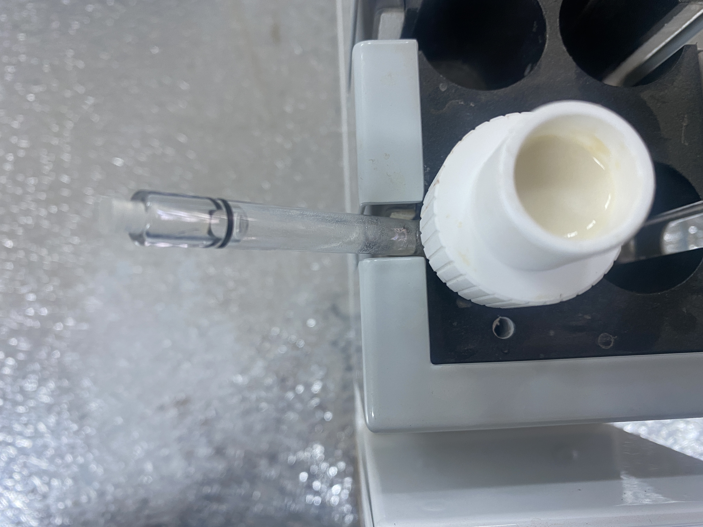
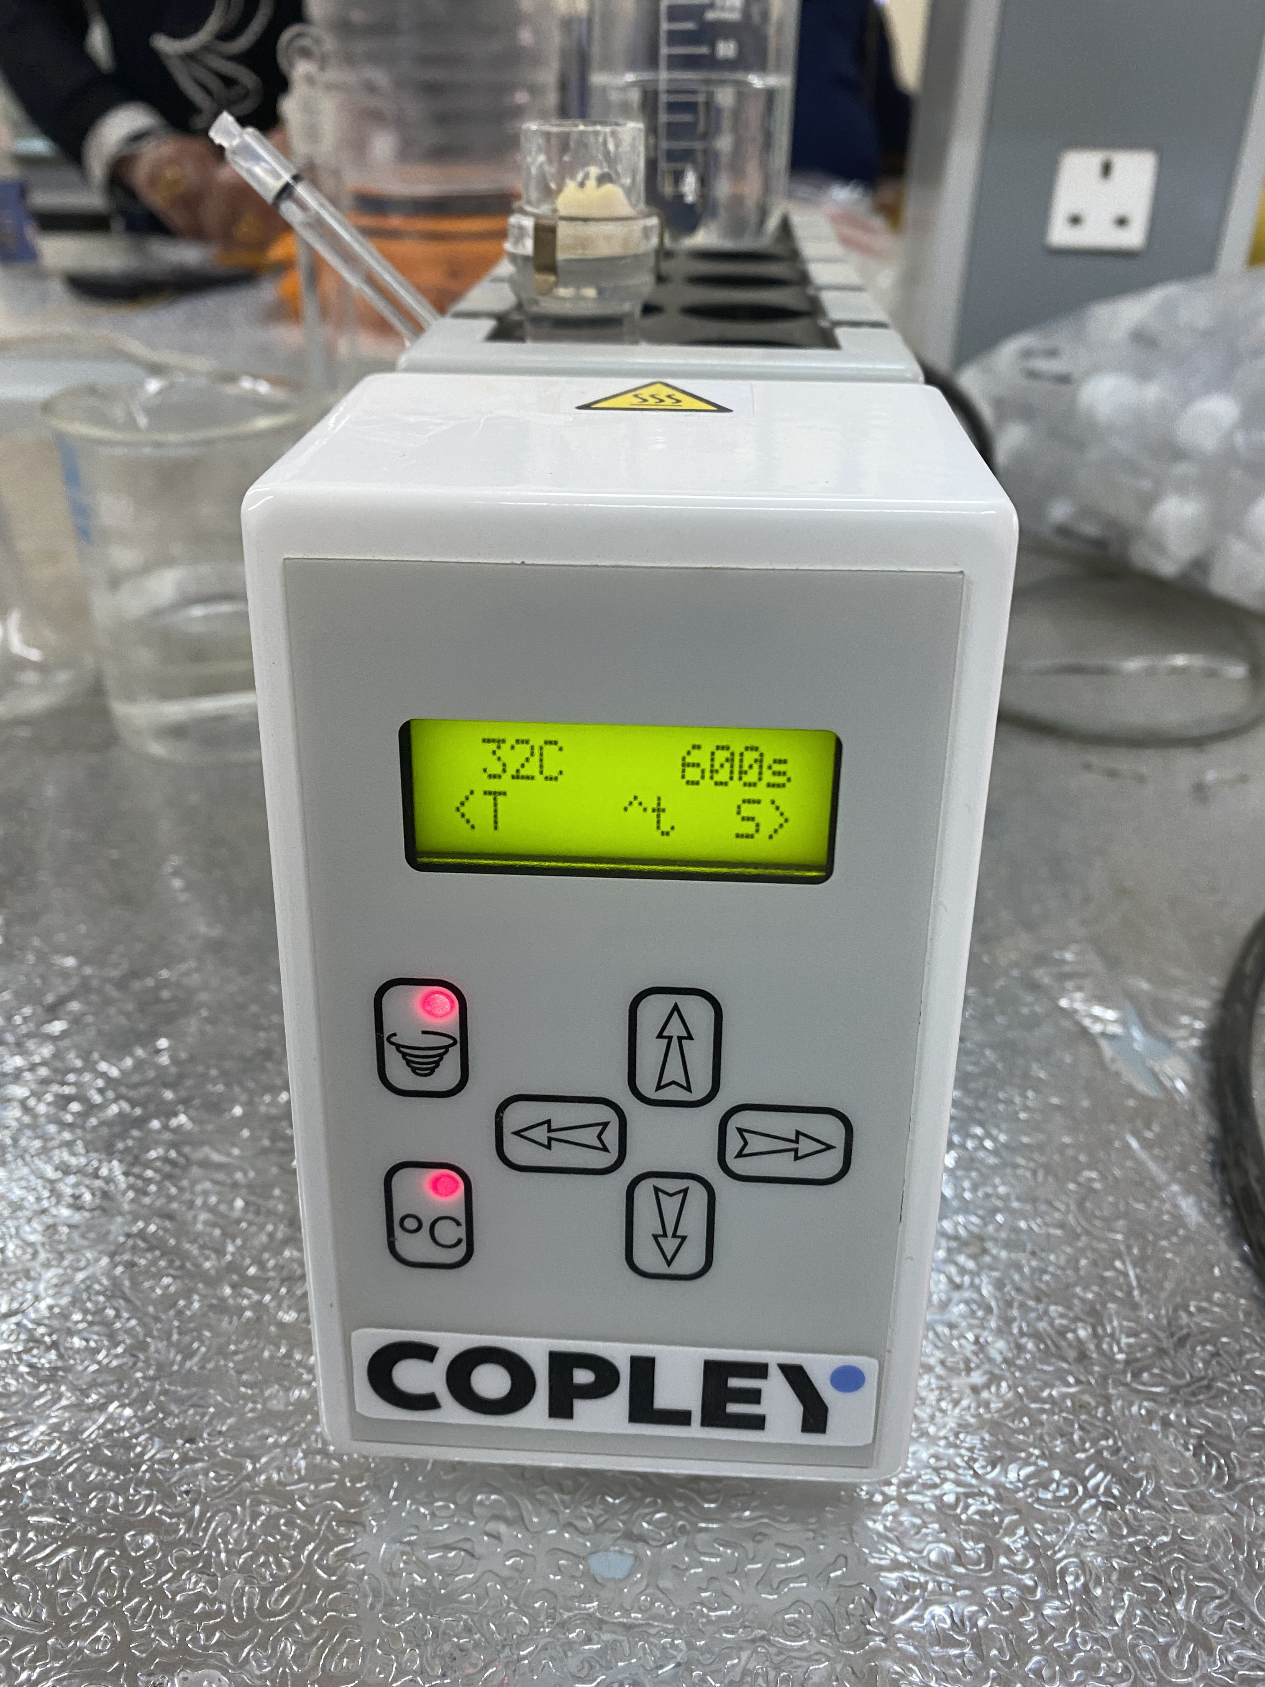
Methodology
Ex-vivo permeation study
Visualization by Transmission Electron Microscope (TEM)
A vertical diffusion cell, HDT 1000 (Copley, UK), was applied for the permeation study. The cell used was 12 ml with a screw-type sample holder
Desired flux ( J) = $\frac{Css X CL}{Area of membrane }$
JSS =$\frac{ Slope of the curve}{ surface area of the membrane}$
Permeability coefficient (Kp) = $\frac{Jss}{Cd}$
Enhancement ratio (ER)=$\frac{Jss of test}{Jss of control}$
The selected formula was visualized for surface images and vesicle size using TEM
Statistical analysis
Results of the experimental work were demonstrated as a mean± standard deviation (SD). One-way analysis of variance (ANOVA) was employed.
Statistical significance was defined as (p<0.05).
Studying in-vitro dissolution profile comparison among optimized formulas and kinetic modeling for the selected formula using the DDSolver add-ins program in MS Excel was done.

Slide 16
Results & Discussion
Ondansetron saturated solubility
Results showed that it was soluble in absolute ethanol.
Ondansetron was very slightly soluble in PBS (26), which agreed with prior research on the effect of raising pH on ONDS solubility.
The addition of SLS at a concentration of 0.5% w/v increases the apparent solubility of ONDS.
Results showed significant effect (p<0.05) of type of terpene on the solubility of ondansetron. In which higher solubility seen with D-Limonene which considered higher lipophilic than other terpenes used.

Slide 17
Results & Discussion
Effect of variables on ondansetron entrapment efficiency (%EE)
1. Effect of type and volume of terpenes
(F1-F9) used β-citronellol, (F10-F18) used α-pinene and (F19-F27) used D-limonene.

Slide 18
Results & Discussion
Analysis of Data
Results showed significant difference in percent of entrapment efficiency (p<0.05).
Data showed that D-Limonene had higher entrapment efficiency, as shown in (F22 and F25), which due to the higher lipophilicity of D-Limonene which expected to entrap ondansetron higher than other terpenes used.
Results showed that the %EE was increased with increase in the volatile oil percent as seen in (F1,F4 and F7) which contained β-Citronellol ,(F10,F13 and F16) which contained α-pinene ,(F19,F22 and F25) which contained D-Limonene.
Data showed no statistically significant effect (p>0.05) for formulas contained β-Citronellol and α-pinene, while results showed significant effect (p<0.05) for formulas contained D-limonene.

Slide 19
Results & Discussion
Effect of variables on ondansetron entrapment efficiency (%EE)
2. Effect of lecithin amount ratio
Different percent (4%,8% and 16% w/v) were used in preparation of formulas and results showed that the EE% was decreased with increase in the percent of lecithin mixture. For (F1,F2 and F3) which contained β-Citronellol , (F10,F11 and F12) which contained α-pinene , and (F19,F20 and F21) which contained D-limonene, respectively.
Data showed significant effect (p<0.05) in the on the increase of lecithin mixture amount on %EE of the prepared formulas using constant volume of terpene and regardless to its type.
Ondansetron incorporated into the invasomal vesicle between the lipophilic chains of the phospholipid molecules. At a low amount of lecithin, ondansetron could be completely incorporated into the bilayer membrane, which explains the high encapsulation efficiency observed at a low amount of lecithin.

Slide 20
Results & Discussion
Vesicle size, polydispersity index, and zeta potential
Optimized formulas with high entrapment efficiency (>80%) were evaluated for size, polydispersity (PDI) and zeta potential (ζ).
β-citronellol (F4 and F7) had higher vesicle size in compare to other formulas.
The type of terpene had a statistically significant effect on vesicle size (p<0.05).These results could be related to the terpene molecular size, which greatly affects the vesicular size.
As the volume of terpene in the vesicle increased from (4% to 8% w/v), the size of the vesicle expanded.
All formulations were monodispersed in which the polydispersity was less than 1 (PDI<1).
Data showed statistically significant effect (p<0.05) of zeta potential among optimized formulas. The incorporation of ethanol made the vesicles acquire a negative charge, which accounts for the negative value of zeta potential.

Slide 21
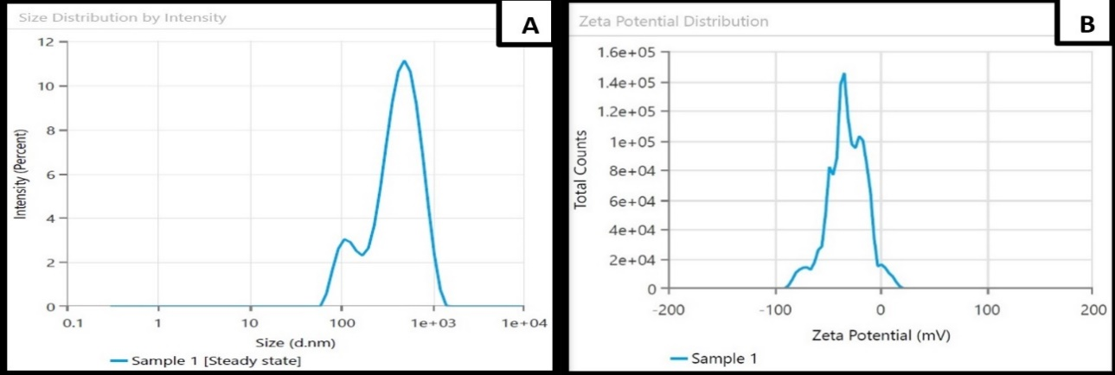
Results & Discussion
Vesicle size, polydispersity index, and zeta potential
Graphical results for (F25), A) Size distribution, B) Zeta potential distribution

Slide 22
Results & Discussion
The In-vitro drug release study
Optimized formulas of ONDS invasomal dispersion were evaluated for in-vitro release. Data showed that all formulas were sustained release.
Results showed that vesicles containing D-Limonene had sustained release after (12 h.) as in (F22 and F25).
A statistically significant difference (p<0.05) among formulations relating to type of terpenes on ondansetron release form vesicles.
lower values of % ondansetron release with time as in (F4, F7) which contain β-citronellol and (F13 and F16), which contain α-pinene.
The low boiling point of D-Limonene (176°C) and α-pinene (156.2°C) compared to β-citronellol (224.5°C) led to weak cohesiveness or self-association of the molecules, which gave higher % drug release.
Results showed that formulas with high percent of terpene (8% v/v) in (F7, F16 and F25) had higher release after 12 h. against lower percent (4% v/v) in (F4,F13 and F22). Results showed significant difference (p<0.05) in the effect of concentration of terpenes used on the release of ondansetron from vesicles regardless to its type.
Using DDSolver for studying in-vitro dissolution profile comparison among optimized formulas showed similarity factor (f2) in comparing (F25) to other optimized formulas. Results showed no similarity in release and (F25) was considered for further evaluation.
Kinetic modeling for selected formula (F25) showed that dissolution follows korsmeyer-peppas model associated with anomalous diffusion (n=0.804) (0.45 < n < 0.89) and this was agreed with the reported results from previous literatures.

Slide 23
Results & Discussion
The In-vitro drug release
Formula | Zero-order |  | First-order |  | Higuchi |  | Korsmeyer-Peppas
 | K_{o} | R² | K₁ | R² | K_{H} | R² | K_{KP} | R² | n
F25 | 6.535 | 0.9760 | 0.098 | 0.9868 | 18.752 | 0.9245 | 10.009 | 0.9961 | 0.804
Dissolution Data Modelling for (F25)

Slide 24
Results & Discussion
The Ex-vivo permeation study
Results showed that flux values for (F22 and F25) containing D-limonene showed significant effect (p<0.05) when compared to the flux values for other formulas that contain β-citronellol (F4 and F7) and α-pinene (F13 and F16).
D-Limonene affects flux due to high lipophilicity and low boiling point in which invasomes associated with the skin layer strongly and efficiently permeate the vesicle so D-Limonene considered as efficient permeation enhancer. The permeation was significantly enhanced (p<0.05) 11.5 times in (F25) compared to conventional ONDS in PBS (10 mg/ml) in which the flux calculated across 1.76 cm2 animal tissue.
Increase the % of terpene from (4% v/v) in (F22) to (8% v/v) in (F25). The permeability increased significantly (p<0.05) this was due to possible differences among the thermodynamic activity of terpenes in vehicle.

Slide 25
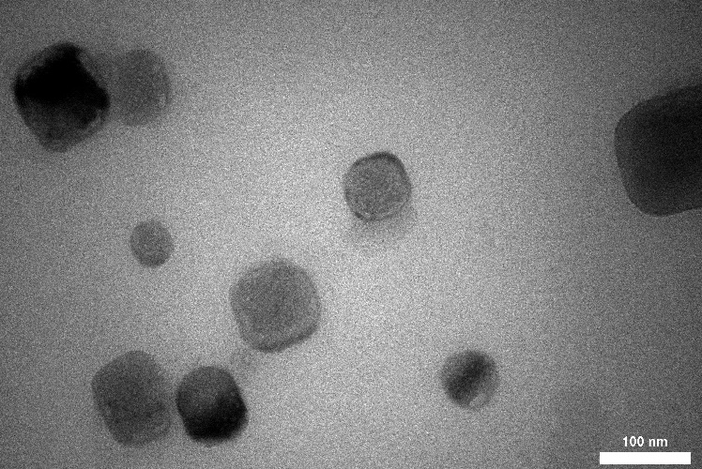
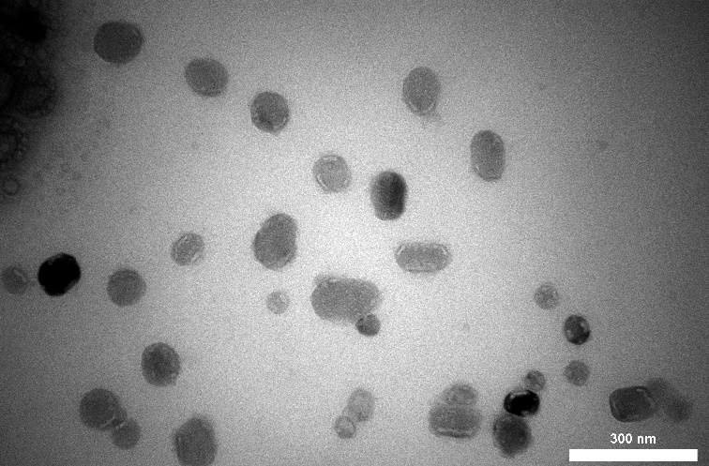
Results & Discussion
Visualization by Transmission Electron Microscope (TEM)
TEM images were taken to visualize the morphology for the selected formula. TEM images for (F25) showed a spherical and deformed shapes at different magnification power.
A) Magnification 27000X) B) Magnification 30000X

Slide 26
Conclusions
Ondansetron-loaded invasomes could be prepared efficiently by the mechanical dispersion method. Formula (25) which contained D-Limonene as permeation enhancer was selected for further evaluation.
Release and permeation pattern of ondansetron were enhanced by using lecithin mixtures and D-Limonene.
Invasomes can be considered a promising delivery system for transdermal delivery of ondansetron to facilitate permeation, increase therapeutic effectiveness and ensuring sustain release along the day.

Slide 27
Bibliographical References
Hashmat D, Shoaib MH, Ali FR, Siddiqui F. Lornoxicam Controlled Release Transdermal Gel Patch: Design, Characterization, and Optimization Using Co-Solvents as Penetration Enhancers. PLoS ONE 2020;15(2):1–23. https://doi.org/10.1371/journal.pone.0228908
Priyanka K, Pentewar R, Bhusnure OG, Thonte SS, Supriya M, Sarda RR. Use of Novel Penetration Enhancers and Techniques in Tdds. Indo American Journal of Pharmaceutical Research 2015;5(9):2752–60.
Jain S, Tripathi S, Tripathi PK. Invasomes: Potential vesicular systems for transdermal delivery of drug molecules. Journal of Drug Delivery Science and Technology 2021;61:102166. https://doi.org/10.1016/j.jddst.2020.102166
Tincello DG. Treatment of Hyperemesis Gravidarum with the 5-HT3 Antagonist Ondansetron (Zofran). Postgraduate Medical Journal 1996;72(853):688–9.https://doi: 10.1136/pgmj.72.853.688.
Alotaibi BS, Pervaiz F, Buabeid M, Ashames A, Fahelelbom KM, Siddique S, et al. Nanostructured Lipid Carriers Based Suppository For Enhanced Rectal Absorption of Ondansetron: In-vitro and In-vivo Evaluations. Arabian Journal of Chemistry 2021;14(12):103426.https://doi.org/10.1016/j.arabjc.2021.103426
Noor AH, Ghareeb MM. Formulation and Evaluation of Ondansetron HCl Nanoparticles for Transdermal Delivery. Iraqi Journal of Pharmaceutical Sciences 2020;29(2):70–9. https://doi.org/10.31351/vol29iss2pp70-79
Ammar HO, Tadros MI, Salama NM, Ghoneim AM. Ethosome-Derived Invasomes as a Potential Transdermal Delivery System for Vardenafil Hydrochloride: Development, Optimization and Application of Physiologically Based Pharmacokinetic Modeling in Adults and Geriatrics International Journal of Nanomedicine 2020;15:5671–85. https:// doi.org/10.2147/IJN.S261764

Slide 28
Bibliographical References
Alkawak RS, Rajab NA. Lornoxicam-Loaded Cubosomes:-Preparation and In-vitro Characterization. Iraqi Journal of Pharmaceutical Sciences 2022 Jun 17;31(1):144-53.https://doi.org/10.31351/vol31iss1pp144-153
Zhang Y, Huo M, Zhou J, Zou A, Li W, Yao C, et al. DDSolver: An add-in program for modeling and comparison of drug dissolution profiles. AAPS Journal 2010;12(3):263-71. https://doi.org/10.1208/s12248-010-9185-1
Guillot AJ, Jornet-Mollá E, Landsberg N, Milián-Guimerá C, Montesinos MC, Garrigues TM, et al. Cyanocobalamin Ultraflexible Lipid Vesicles: Characterization and In-vitro Evaluation of Drug-Skin Depth Profiles. Pharmaceutics 2021;13(3). https:// doi. org /10.33 90/pharmaceutics13030418
Dutta Tejaswi DJK. Estimation of Ondansetron Hydrochloride By Rp-HPLC. EPRA International Journal of Research & Development (IJRD) 2020;5(5):29–34. https:// doi.org/10.36713/epra2016
Krishnaiah YSR, Rama B, Raghumurthy V, Ramanamurthy K V., Satyanarayana V. Effect of PEG6000 on The In-vitro and In-vivo Transdermal Permeation of Ondansetron Hydrochloride from EVA1802 membranes. Pharmaceutical Development and Technology 2009;14(1):53–64.https://doi.org/10.1080/10837450802409404
Abd E, Yousef SA, Pastore MN, Telaprolu K, Mohammed YH, Namjoshi S, Grice JE, Roberts MS. Skin Models for the Testing of Transdermal Drugs. Clinical pharmacology: advances and applications 2016;8:163. https://doi.org/10.2147/CPAA.S64788
Anitha P, Satyanarayana S V. Design and Optimization of Nano Invasomal Gel of Glibenclamide and Atenolol Combination: In-vitro and In-vivo Evaluation. Future Journal of Pharmaceutical Sciences 2021;7(1).https://doi.org/10.1186/s43094-021-00240-4.

Slide 29
Bibliographical References
Badr-Eldin SM, Ahmed OAA. Optimized Nano-Transfersomal Films for Enhanced Sildenafil Citrate Transdermal Delivery: Ex-vivo and In-vivo Evaluation. Drug Design, Development and Therapy 2016;10:1323–33.https://doi.org/10.2147/DDDT.S103122
Al Abood RM, Talegaonkar S, Tariq M, Ahmad FJ. Microemulsion as a Tool for the Transdermal Delivery of Ondansetron for the Treatment of Chemotherapy Induced Nausea and Vomiting. Colloids and Surfaces B: Biointerfaces 2013;101:143–51. https:// doi.org/ 10.1016/j.colsurfb.2012.06.015
Abdulbaqi MR, Rajab NA. Preparation, Characterization and Ex-vivo Permeability Study of Transdermal Apixaban O/W Nanoemulsion Based Gel. Iraqi Journal of Pharmaceutical Sciences 2021;29(2):214–22.https://doi.org/10.31351/vol29iss2pp214-222
Thamer AK, Abood AN. Preparation and In-vitro Characterization of Aceclofenac Nanosuspension (ACNS) for Enhancement of Percutaneous Absorption using Hydrogel Dosage Form. Iraqi Journal of Pharmaceutical Sciences 2021;30(2):86-98. https://doi.org/10.31351/vol30iss2pp86-98
Sinko, Patrick J., et al. Physical Chemical and Biopharmaceutical Principles in the Pharmaceutical Sciences. Martin's Physical Pharmacy and Pharmaceutical Sciences.6th Edition, MD : Lippincott Williams &amp. Baltimore 2011: 182-96
Rasheedy MM, El-mahdy MM, Fathallah D, Ibrahim EA. Bulletin of Pharmaceutical Formulation and evaluation of ondansetron transdermal gels 2017;40:57–70. https:// doi.org/10.21608/bfsa.2017.63166
Ahmed OAA, Badr-Eldin SM. Development of An Optimized Avanafil-Loaded Invasomal Transdermal Film: Ex-vivo Skin Permeation and In-vivo Evaluation. International Journal of Pharmaceutics 2019;570:118657. https://doi.org/10.1016/j. ijpharm.2019. 118657

Slide 30
Bibliographical References
Habib BA, Sayed S, Elsayed GM. Enhanced Transdermal Delivery of Ondansetron Using Nanovesicular Systems: Fabrication, Characterization, Optimization and Ex-vivo Permeation Study-Box-Cox Transformation Practical Example. European Journal of Pharmaceutical Sciences. 2018;115:352–61.https://doi.org/10.1016/j.ejps.2018.01.044
National Committee for Research Ethics in Science and Techno. Guidelines for Research Ethics in Science and Technology. Jahrbuch für Wissenschaft und Ethik 2009;14(1):255–66.
Kumar B, Sahoo PK, Manchanda S. Formulation, Characterization and Ex-vivo Study of Curcumin Nano-Invasomal Gel For Enhanced Transdermal Delivery OpenNano. 2022;7:100058.https://doi.org/10.1016/j.onano.2022.100058
Veseli A, Žakelj S, Kristl A. A review of Methods for Solubility Determination in Biopharmaceutical Drug Characterization.Drug Development and Industrial Pharmacy 2019;45(11):1717–24.https://doi.org/10.1080/03639045.2019.1665062
Mura S, Manconi M, Sinico C, Valenti D, Fadda AM. Penetration Enhancer-Containing Vesicles (PEVs) As Carriers for Cutaneous Delivery of Minoxidil. International Journal of Pharmaceutics 2009;380(1–2):72–9.https://doi.org/10.1016/j.ijpharm.2009.06.040
Vidya K, Lakshmi PK. Cytotoxic Effect of Transdermal Invasomal Anastrozole Gel on MCF-7 Breast Cancer Cell Line. Journal of Applied Pharmaceutical Science 2019;9(3):50–8.https://doi.org/10.7324/JAPS.2019.90308

Slide 31
Bibliographical References
Albash R, Al-Mahallawi AM, Hassan M, Alaa-Eldin AA. Development and Optimization of Terpene-Enriched Vesicles (Terpesomes) for Effective Ocular Delivery of Fenticonazole Nitrate: In -vitro Characterization and In-vivo Assessment. International Journal of Nanomedicine 2021;16:609–21.https://doi.org/10.2147/IJN.S274290
Alkawak RS, Rajab NA. Lornoxicam-Loaded Cubosomes:-Preparation and In-vitro Characterization. Iraqi Journal of Pharmaceutical Sciences 2022 Jun 17;31(1):144-53.https://doi.org/10.31351/vol31iss1pp144-153
Zhang Y, Huo M, Zhou J, Zou A, Li W, Yao C, et al. DDSolver: An add-in program for modeling and comparison of drug dissolution profiles. AAPS Journal 2010;12(3):263-71. https://doi.org/10.1208/s12248-010-9185-1
Guillot AJ, Jornet-Mollá E, Landsberg N, Milián-Guimerá C, Montesinos MC, Garrigues TM, et al. Cyanocobalamin Ultraflexible Lipid Vesicles: Characterization and In-vitro Evaluation of Drug-Skin Depth Profiles. Pharmaceutics 2021;13(3). https:// doi. org /10.33 90/pharmaceutics13030418
Dutta Tejaswi DJK. Estimation of Ondansetron Hydrochloride By Rp-HPLC. EPRA International Journal of Research & Development (IJRD) 2020;5(5):29–34. https:// doi.org/10.36713/epra2016
Krishnaiah YSR, Rama B, Raghumurthy V, Ramanamurthy K V., Satyanarayana V. Effect of PEG6000 on The In-vitro and In-vivo Transdermal Permeation of Ondansetron Hydrochloride from EVA1802 membranes. Pharmaceutical Development and Technology 2009;14(1):53–64.https://doi.org/10.1080/10837450802409404
Abd E, Yousef SA, Pastore MN, Telaprolu K, Mohammed YH, Namjoshi S, Grice JE, Roberts MS. Skin Models for the Testing of Transdermal Drugs. Clinical pharmacology: advances and applications 2016;8:163. https://doi.org/10.2147/CPAA.S64788

Slide 32
Bibliographical References
Anitha P, Satyanarayana S V. Design and Optimization of Nano Invasomal Gel of Glibenclamide and Atenolol Combination: In-vitro and In-vivo Evaluation. Future Journal of Pharmaceutical Sciences 2021;7(1).https://doi.org/10.1186/s43094-021-00240-4
Badr-Eldin SM, Ahmed OAA. Optimized Nano-Transfersomal Films for Enhanced Sildenafil Citrate Transdermal Delivery: Ex-vivo and In-vivo Evaluation. Drug Design, Development and Therapy 2016;10:1323–33.https://doi.org/10.2147/DDDT.S103122
Al Abood RM, Talegaonkar S, Tariq M, Ahmad FJ. Microemulsion as a Tool for the Transdermal Delivery of Ondansetron for the Treatment of Chemotherapy Induced Nausea and Vomiting. Colloids and Surfaces B: Biointerfaces 2013;101:143–51. https:// doi.org/ 10.1016/j.colsurfb.2012.06.015
Abdulbaqi MR, Rajab NA. Preparation, Characterization and Ex-vivo Permeability Study of Transdermal Apixaban O/W Nanoemulsion Based Gel. Iraqi Journal of Pharmaceutical Sciences 2021;29(2):214–22.https://doi.org/10.31351/vol29iss2pp214-222
Thamer AK, Abood AN. Preparation and In-vitro Characterization of Aceclofenac Nanosuspension (ACNS) for Enhancement of Percutaneous Absorption using Hydrogel Dosage Form. Iraqi Journal of Pharmaceutical Sciences 2021;30(2):86-98. https://doi.org/10.31351/vol30iss2pp86-98
Sinko, Patrick J., et al. Physical Chemical and Biopharmaceutical Principles in the Pharmaceutical Sciences. Martin's Physical Pharmacy and Pharmaceutical Sciences.6th Edition, MD : Lippincott Williams &amp. Baltimore 2011: 182-96

Slide 33
Bibliographical References
Rasheedy MM, El-mahdy MM, Fathallah D, Ibrahim EA. Bulletin of Pharmaceutical Formulation and evaluation of ondansetron transdermal gels 2017;40:57–70. https:// doi.org/10.21608/bfsa.2017.63166
Ahmed OAA, Badr-Eldin SM. Development of An Optimized Avanafil-Loaded Invasomal Transdermal Film: Ex-vivo Skin Permeation and In-vivo Evaluation. International Journal of Pharmaceutics 2019;570:118657. https://doi.org/10.1016/j. ijpharm.2019. 118657
Dsouza L, Chaudhari P, Brahmam B, Lewis SA. Derma Roller Mediated Transdermal Delivery of Tizanidine Invasomes for the Management of Skeletal Muscle Spasms. European Journal of Pharmaceutical Sciences 2021;165:105920. https:// doi. org/10.1016/j.ejps.2021.105920
El-Nabarawi MA, Shamma RN, Farouk F, Nasralla SM. Dapsone-Loaded Invasomes as a Potential Treatment of Acne: Preparation, Characterization, and In-vivo Skin Deposition Assay. AAPS PharmSciTech 2018;19(5):2174–84.https://doi.org/10.1208/s12249-018-1025-0
Tabandeh H, Mortazavi SA. An Investigation into Some Effective Factors on Encapsulation Efficiency of Alpha-Tocopherol in MLVs and the Release Profile From the Corresponding Liposomal Gel. Iranian Journal of Pharmaceutical Research 2013;12(SUPPL.):19–28.
Hammoud Z, Gharib R, Fourmentin S, Elaissari A, Greige-Gerges H. New Findings on the Incorporation of Essential Oil Components into Liposomes Composed of Lipoid S100 and Cholesterol. International Journal of Pharmaceutics 2019;561:161–70. https:// doi.org/10.1016/j.ijpharm.2019.02.022
Midekessa G, Godakumara K, Ord J, Viil J, Lättekivi F, Dissanayake K, et al. Zeta Potential of Extracellular Vesicles: Toward Understanding the Attributes that Determine Colloidal Stability. ACS Omega 2020;5(27):16701–10.https://doi.org/10.1021/ acsomega. 0c01582

Slide 34
Bibliographical References
Sinico C, Manconi M, Peppi M, Lai F, Valenti D, Fadda AM. Liposomes as Carriers for Dermal Delivery of Tretinoin: In-vitro Evaluation of Drug Permeation and Vesicle–Skin Interaction. Journal of Controlled Release 2005;103(1):123-36. https://doi. org/10.1016/j.jconrel.2004.11.020
Katahira N, Murakami T, Kugai S, Yata N, Takano M. Enhancement of Topical Delivery of a Lipophilic Drug from Charged Multilamellar Liposomes. Journal of Drug Targeting 1999;6(6):405-14. https://doi.org/10.3109/10611869908996847
Sinico C, Valenti D, Manconi M, Lai F, Fadda AM. Cutaneous Delivery of 8-Methoxypsoralen from Liposomal and Niosomal Carriers. Journal of Drug Delivery Science and Technology 2006;16(2):115-20.https://doi.org/10.1016/S1773-2247 (06) 50017-6
Wu IY, Bala S, Škalko-Basnet N, di Cagno MP. Interpreting Non-Linear Drug Diffusion Data:Utilising Korsmeyer-Peppas Model to Study Drug Release From Liposomes. European Journal of Pharmaceutical Sciences 2019;138:105026.https://doi.org/10.1016/j. ejps.2019.105026
Choube MKD and RN. Formulation and Evaluation of Transdermal Therapeutic System of Ondansetron Hydrochloride. Current Trends in Pharmaceutical Research 2012;1(1): p. 13–32.
Narishetty ST, Panchagnula R. Transdermal Delivery of Zidovudine: Effect of Terpenes and Their Mechanism of Action. Journal of Controlled Release 2004;95(3):367-79. https:// 10.1016/j.jconrel.2003.11.022
El-Kattan AF, Asbill CS, Kim N, Michniak BB. The Effects Of Terpene Enhancers on the Percutaneous Permeation of Drugs with Different Lipophilicities. International Journal of Pharmaceutics 2001;215(1–2):229–40. https://doi.org/10.1016/s0378-5173(00)00699-2
Ahad A, Al-Mohizea AM, Al-Jenoobi FI, Aqil M. Transdermal Delivery of Angiotensin II Receptor Blockers (Arbs), Angiotensin-Converting Enzyme Inhibitors (Aceis) and Others for Management of Hypertension. Drug Delivery 2016;23(2):579–90. https://doi. org/10.3109/10717544.2014.942444

Slide 35
Thanks!
Do you have any questions?

