Slide 1
Study of Association between Adhesion Molecule Alpha-4 Integrin Genes Polymorphism and Response to Natalizumab in a Sample of Iraqi Patients with Multiple Sclerosis
Fadia Thamir Ahmed
PhD Student/ Clinical Pharmacy Department
College of Pharmacy/ University of Baghdad
Under Supervision:
Professor Dr. Shatha H. Ali
College of Pharmacy/ University of Baghdad
Assist. Prof. Dr. Geyath A. A. Al-Gawwam
College of Medicine/ University of Baghdad
المؤتمر العلمي الثاني لبحوث طلبة الدراسات العليا
15 – 16 اذار 2023

Slide 2
Introduction
Multiple sclerosis (MS) is a potentially progressive, autoimmune neurologic disorder of the central nervous system (CNS) resulting from autoimmune attack on CNS white matter.
Epidemiology
In Iraq, MS has a significant increased incidence, while prevalence is still low compared to neighboring countries.
Relapsing Remitting MS (RRMS) was the most common clinical form.
Overall prevalence: 11.73 per 100,000 Iraqi persons.
Prevalence in males: 7.3 per 100,000 Iraqi males,
Prevalence in females: 16.2 per 100,000 Iraqi females.
Prevalence in ages <12 years: 0.26 per 100,000 persons.

Slide 3
Pathogenesis

Slide 4
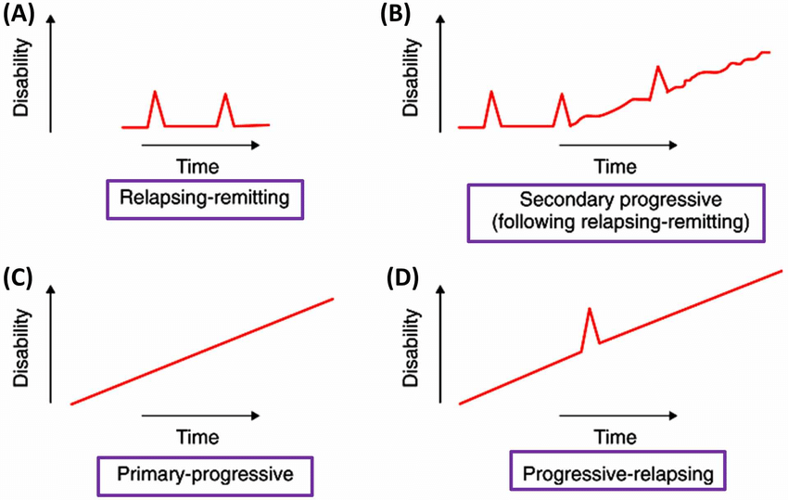
Disease Subtypes
-Relapsing remitting MS (RRMS) -Primary progressive MS (PPMS)
-Secondary progressive MS (SPMS) -progressive relapsing MS (PRMS)

Slide 5
Clinical Presentation

Slide 6
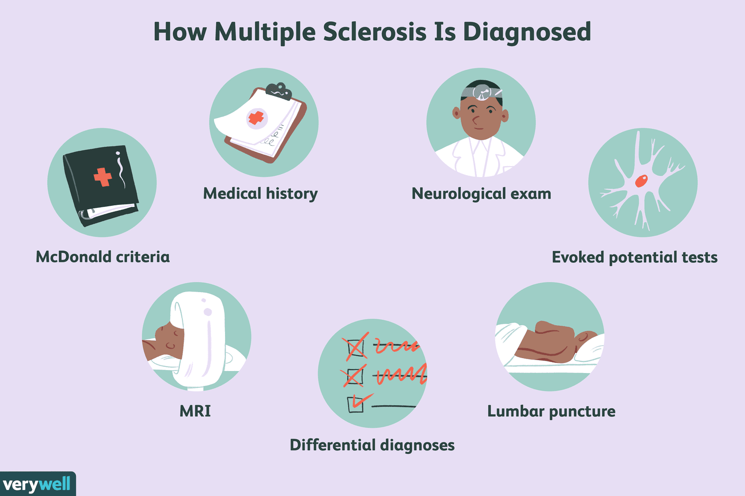
Diagnosis
Multiple sclerosis is a diagnosis of exclusion as symptoms can frequently be attributed to other neurologic diseases, just as many syndromes can mimic MS.
Diagnostic Criteria: McDonald criteria.
Diagnostic Investigations:
Magnetic Resonance Imaging (MRI).
Blood and Cerebrospinal Fluid (CSF).
Evoked Potentials (EPs).
Retinal Optical Coherence Tomography (OCT).
The Expanded Disability Status Scale (EDSS).

Slide 7
Pharmacological Treatment

Slide 8
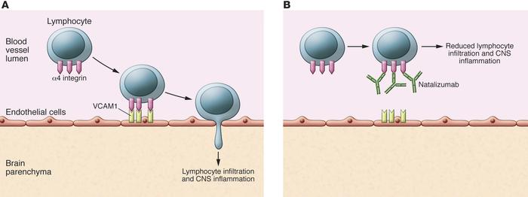
Natalizumab
Natalizumab (Tysabri®, Biogen-Idec Inc., NAT), a humanized anti-α4 integrin monoclonal antibody, which binds integrin α4 subunit that is present in both α4β1 and α4β7 integrins, could reduce inflammation and prevent lymphocyte migration to the CNS, thus is approved for the treatment of MS and Crohn’s disease.

Slide 9
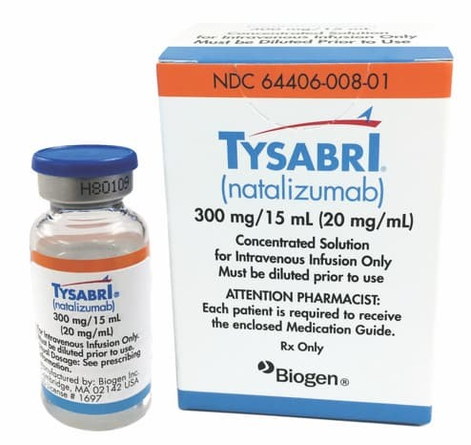
Administration and Dosing
Natalizumab is indicated as monotherapy for the treatment of patients with relapsing remitting MS (RRMS).
The currently approved natalizumab regimen of 300 mg administered intravenously (IV infusion) every 4 weeks

Slide 10
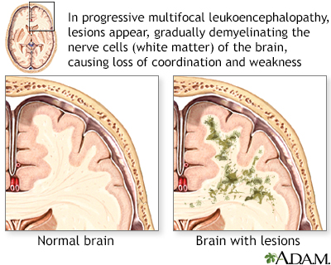
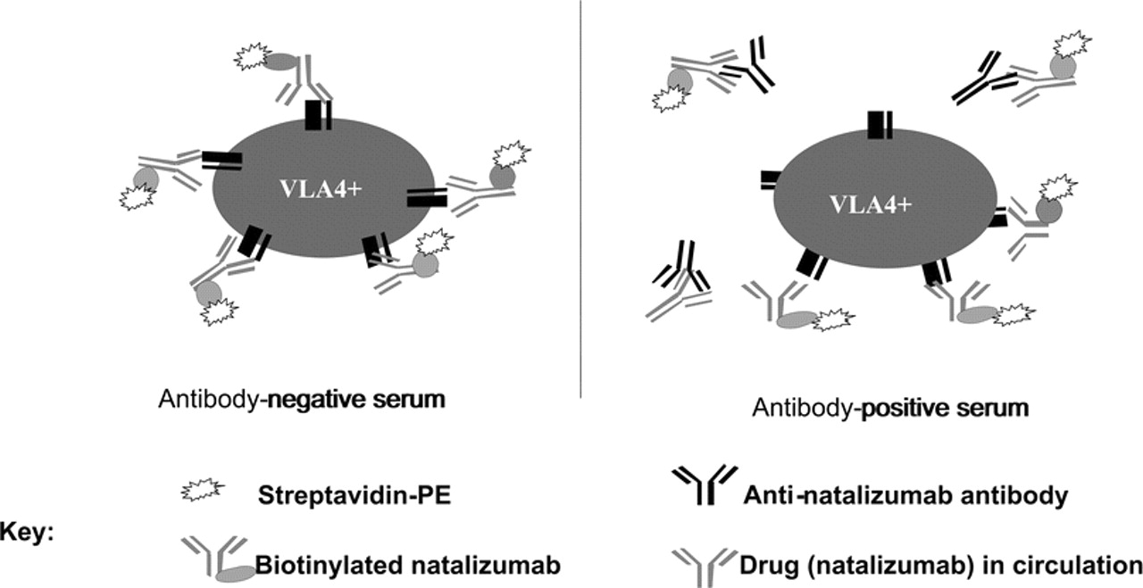
Safety and Cost
1- Progressive multifocal leukoencephalopathy (PML) due to reactivation of John Cunningham virus (JCV).
2- Infusion-related reactions.
3- Antidrug antibodies (ADA) generation with this treatment.
4- Annual cost of NAT treatment is about $36,000 in 2022.

Slide 11
Genetic Polymorphism and Response to NAT
Multiple sclerosis is a ‘‘complex genetic disease’’, defined by a non-Mendelian and non-mitochondrial mode of inheritance and a multifactorial origin that is at least partially linked to the environment.
The aim of identifying genetic markers able to predict treatment response and susceptibility to drug toxicity has led to the attempt of applying pharmacogenetics and pharmacogenomics approach to MS therapy.
Notes:
Genetic alterations in genes involved in the mechanism of action of the drug or in the pathologic environment of the disease may play a crucial role in this phenomenon. Genetic polymorphisms associate with some variability in drug response as well as risk of experiencing a serious adverse drug reaction (ADR).

Slide 12
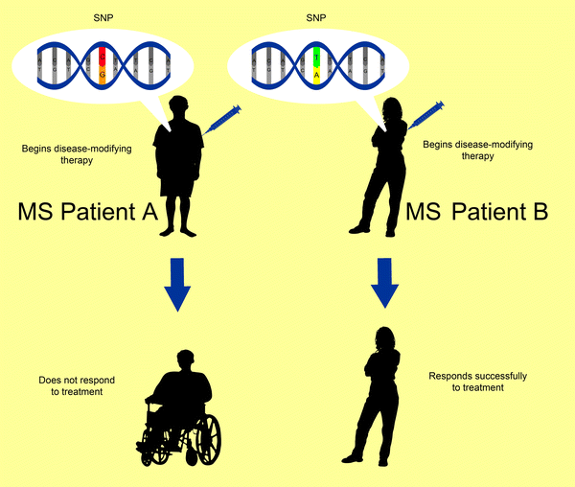
Genetic Polymorphism and Response to NAT
As migration of immune cells into the CNS is facilitated by the VLA-4 integrin molecule, the VLA-4 gene may be considered as a plausible candidate gene.
Many residues in the ITGA-4 gene have been identified as the main α4 residues to which NAT binds and they can impact its action.
The importance SNP at amino acid position 256 (rs200000911, A˃G,T) is the target polymorphism in the current study.

Slide 13
Aims of The Study:
The present study was designed to :
1. To measure the prevalence of genotypes and specific alleles or single nucleotide polymorphism (SNP) in promotor site of ITGA4 gene at amino acid position 256 (rs200000911, A˃G,T) in exon 1) in a sample of Iraqi MS patients.
2. To study the association between different genotypes of these variants and the tendency for being non-responsive to natalizumab therapy.

Slide 14
Patients and Methods
A cross-sectional, single center research has been carried out at the Medical City Complex Baghdad Teaching Hospital, Department of Neurology from March to August/ 2022.
The research protocol has been approved by College of Pharmacy Scientific and Ethical Committee, University of Baghdad (approval number: RECAUBCP25102021A; approval date: 25/10/2021).

Slide 15
Inclusion criteria
Confirmed MS diagnosis by specialized neurologists.
The patients must had taken NAT by intravenous infusion, regularly every 28 days for at least 12 previous consecutive months.
Exclusion criteria
Patients who are using NAT for less than 12 months.
Patients using MS medications other than NAT.
Patients with co-existent other neurological diseases.
Notes:
through clinical proof of central nervous system (CNS) involvement, brain magnetic resonance imaging (MRI), and other diseases exclusion

Slide 16
Data Collection
An information chart designed by the researchers was used to collect the demographic data including age, gender, duration of disease, NAT doses number and relapse number in the last 12 months by direct interview.
The baseline (before NAT treatment) Expanded Disability Status Scale (EDSS) has been collected from the patients' files, while the current EDSS was estimated by the neurologist.

Slide 17
Patients' Groups and Clinical Assessment
The responsiveness of NAT-treated patients was determined by the presence of a steady or decreased EDSS and relapse absence.
In contrast, NAT-unresponsive MS patients were diagnosed based on an elevated EDSS despite treatment and the occurrence of relapses during therapy.

Slide 18
Patients' Groups and Clinical Assessment
Furthermore ,the development of anti- NAT neutralizing antibodies was investigated by a specific ELISA kit to exclude antibody positive patients from the NAT unresponsive group.
Serum VCAM-1 concentration was measured to confirm the effectiveness of NAT.

Slide 19
Anti- NAT neutralizing antibodies ELISA kit
Natalizumab antibody screening (qualitative) enzyme-linked immunosorbent assay (ELISA) kit (ELISA Genie Corporation, Ireland).
Vascular Cell Adhesion Molecule 1 (VCAM1) ELISA Kit
A sandwich enzyme immunoassay kit for in vitro (quantitative) measurement of VCAM1 in human serum (Cloud-Clone Corporation, China).
Statistical Analysis
Version 24 of Statistical Package for the Social Sciences (SPSS) (IBM Corp., USA) was utilized to perform statistical analysis.

Slide 20
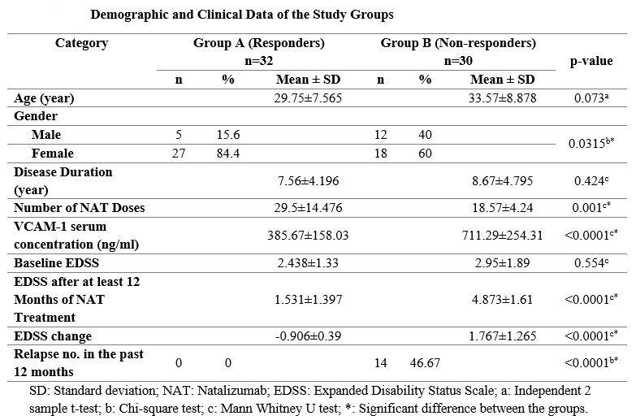
Results
Demographic and Clinical Characteristics

Slide 21
Correlations between Genotypes and the Propensity of NAT Non-response
1- 256, A˃G,T: had a non-significant correlation with likelihood of non-response to NAT (p-value:0.898).
2- rs936587744, T˃C (Intronic SNP): had a non-significant correlation with likelihood of non-response to NAT (p-value:0.974).
3- rs2305588, T˃C (Intronic SNP): had a non-significant correlation with likelihood of non-response to NAT (p-value:0.092 and 0.067 for the heterozygote and homozygote genotypes respectively).

Slide 22
Correlations between Genotypes and VCAM-1 Serum Concentration
1- 256, A˃G,T: had a non-significant correlation with VCAM-1 serum conc. (p-value:0.358).
2- rs936587744, T˃C (Intronic SNP): had a non-significant correlation with VCAM-1 serum conc. (p-value:0.165).
3- rs2305588, T˃C (Intronic SNP): had a non-significant correlation with VCAM-1 serum conc. (p-value:0.983).

Slide 23
Correlations between Genotypes and EDSS Change
1- 256, A˃G,T: had a non-significant correlation with EDSS change (p-value:0.536).
2- rs936587744, T˃C (Intronic SNP): had a non-significant correlation with EDSS change (p-value:0.353).
3- rs2305588, T˃C (Intronic SNP): had a non-significant correlation with EDSS change (p-value:0.082)

Slide 24
Correlations between Genotypes and Relapse Rate
1- 256, A˃G,T: had a non-significant correlation with Relapse rate (p-value:0.429).
2- rs936587744, T˃C (Intronic SNP): had a non-significant correlation with Relapse rate (p-value:0.949).
3- rs2305588, T˃C (Intronic SNP): had a non-significant correlation Relapse rate (p-value:0.614).

Slide 25
Limitations
The primary limitation of the current study is the small sample size.
Moreover, the correlation between the response and NAT doses number was not examined.
Furthermore, because this study only encompassed a single center, the outcomes can't be extrapolated to all Iraqi MS patients.
Additionally, due to inadequate facilities and a lack of funding, this study was unable to be expanded to encompass a reasonable follow-up duration for patients with genotypes.

Slide 26
Conclusions
According to the results of this study, patients who do not respond to NAT have higher VCAM-1 serum levels than those who did respond.
Sanger sequencing of the ITGA-4 gene revealed three SNPs, the primary target SNP of this study (rs200000911 (A˃G,T)) in addition to the presence of other two intronic SNPs (rs936587744 (T˃C) and rs2305588 (T˃C)).
The three polymorphisms had no significant effect on the propensity of being a non-responder to NAT in Iraqi MS patients.

Slide 27
Recommendations for further works:
1- A large prospective longitudinal research to examine the influence of these SNPs on the response to NAT in order to prove or disprove our findings.
2- Additional research on other polymorphisms in ITGA-4 or other targets such as VCAM-1 that may affect the response to NAT.
3- Since the impact of these SNPs on NAT responsiveness have not confirmed by the current study and no previous research explored the effect of these mutations on NAT action in other populations. Hence, larger scale studies involving a wide variety of ethnic populations is recommended.
4- Further studies are required to investigate the correlation between genetic polymorphisms and the response of other biological agents used in Iraqi MS patients, such as Rituximab.

Slide 28
Thank You
for Listening

